Slide 1
Periodic functions and Fourier series

Slide 2
Introduction
In this topic, we will
Describe an inner product of two functions
Define orthogonality of functions
Show that we can project one function onto another
Discuss projections onto a set of mutually orthogonal functions
Introduce complex exponential functions
Show that these functions are mutually orthogonal
Approximate periodic functions with these complex exponential functions

Slide 3
An inner product for functions
Suppose we have an interval [–½T, ½T], and given two piecewise continuous periodic functions f and g with period T, we may define
Contrast this with

Slide 4
An inner product for functions
This has all the properties of the inner product of finite-dimensional vectors

Slide 5
An inner product for functions
Two functions are orthogonal if
We can define the 2-norm of a function:
We can also define the projection of one function onto another

Slide 6
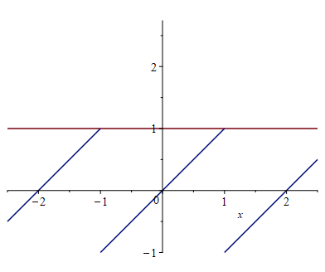
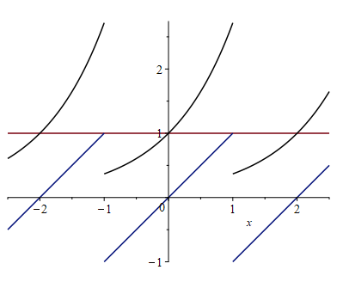
Two orthogonal functions and a projection
For example, the constant function f₀ together with the saw-tooth function f₁ with period T = 2 form an orthogonal set:
If g(t) = e^{t} on [–1, 1] is periodically extended
t

Slide 7
Two orthogonal functions and a projection
Doing the calculations:

Slide 8
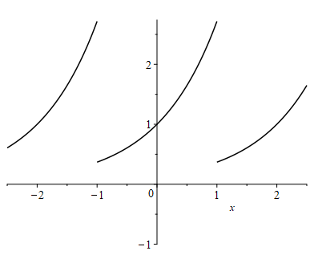
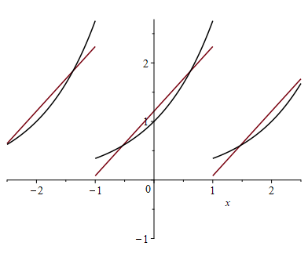
Two orthogonal functions and a projection
Thus, the best approximation of the periodically extended function e^{t} as a linear combination is the periodic extension of
t

Slide 9
Orthogonal complex exponentials
Next, consider the complex-valued functions where n is any integer

Slide 10
Orthogonal complex exponentials
Now, if m = n, we have:

Slide 11
Orthogonal complex exponentials
Otherwise, if m ≠ n, we have:

Slide 12
Orthogonal complex exponentials
Recall that z – z* = 2j ℑm(z)

Slide 13
Orthogonal complex exponentials
Thus, if , we have

Slide 14
Orthogonal complex exponentials
Question: what is the span of all functions
…, u_{–2}(t), u_{–1}(t), u₀(t), u₁ (t), u₂(t), … ?
At the very least, the span contains all periodic functions with period T (including constant functions) with a finite number of discontinuities on any period

Slide 15
Orthogonal complex exponentials
What do these functions look like?

Slide 16
A Fourier approximation
Given a function f (t), we’d like to find the coefficients

Slide 17
A Fourier approximation
If f (t) is real periodic function, then a_{–k} = a_{k}*
Also, f (t) is real periodic function, then a_{–k} = a_{k}*
Without going through the math, this equals

Slide 18
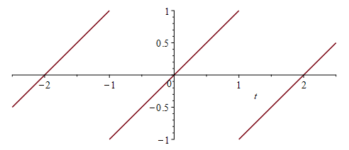
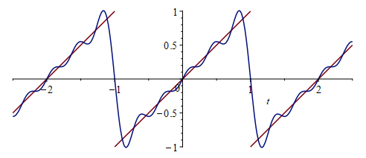
A Fourier approximation
Consider the periodic extension of the polynomial t on [–1, 1] which creates a saw-tooth function

Slide 19
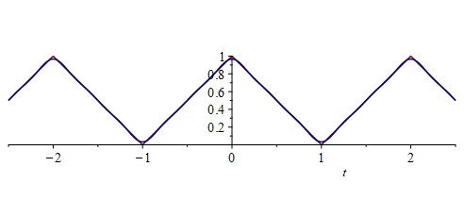
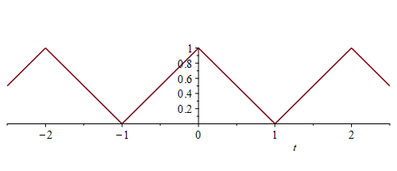
A Fourier approximation
Consider the periodic extension of the function 1 – |t| on [–1, 1] which creates a periodic tent function

Slide 20
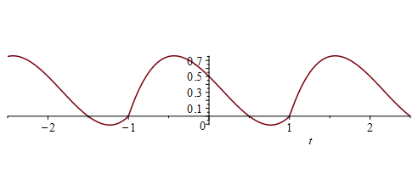
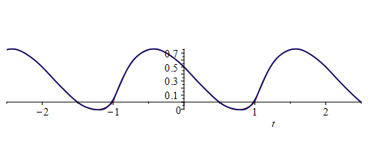
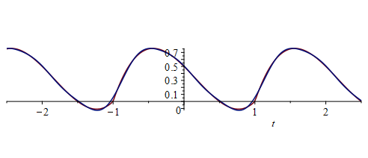
A Fourier approximation
Consider the periodic extension of (t – 1) (t + 1) (t – ½) on [–1, 1] which creates a non-symmetric wave

Slide 21
Maple code
Here is the Maple code:
> restart;
> T := 2;
> p := t -> (t - 1)*(t + 1)*(t - 1/2);
> N := 5;
> interface( imaginaryunit = 'j' );
> for k from -N to N do
a[k] := int( exp( -j*2*Pi/T*k*t )*p(t), t = -T/2..T/2 )/T;
end do;
> plots[display]( plot( p(t), t = -0.5*T..0.5*T ), plot( add( a[k]*exp( j*2*Pi/T*k*t ), k = -N..N ), t = -1.25*T..1.25*T ) );
> a[0] + add( 2*abs(a[k])*cos(2*Pi/T*t + argument(a[k])),
k = 1..N );

Slide 22
Other Fourier series
There are other collections of orthogonal functions that use trigonometric functions
This is easier to visualize
This is more frustrating to calculate with twice as many integrals and integrals involving trigonometric functions
Also, a phase shifted cosine is easier to understand than a sum of two trigonometric functions

Slide 23
Summary
Following this topic, you now
Understand the inner product of two functions
Know that two functions can be orthogonal
Know how to project one function onto another
Are aware that the sum of projections onto orthogonal functions gives the best approximation of the given function in terms of those orthogonal functions
Know about the complex exponential functions
Know these are orthogonal and form a basis for functions of period T
Have seen examples of approximating periodic functions with a finite number of these complex exponential functions

Slide 24
References
[1] https://en.wikipedia.org/wiki/Fourier_series# Complex-valued_functions
[2] Maplesoft: https://www.Maplesoft.com/

Slide 25
Acknowledgments
None so far.

Slide 26
Colophon
These slides were prepared using the Cambria typeface. Mathematical equations use Times New Roman, and source code is presented using Consolas. Mathematical equations are prepared in MathType by Design Science, Inc.
Examples may be formulated and checked using Maple by Maplesoft, Inc.
The photographs of flowers and a monarch butter appearing on the title slide and accenting the top of each other slide were taken at the Royal Botanical Gardens in October of 2017 by Douglas Wilhelm Harder. Please see
https://www.rbg.ca/
for more information.

Slide 27
Disclaimer
These slides are provided for the ece 204 Numerical methods course taught at the University of Waterloo. The material in it reflects the author’s best judgment in light of the information available to them at the time of preparation. Any reliance on these course slides by any party for any other purpose are the responsibility of such parties. The authors accept no responsibility for damages, if any, suffered by any party as a result of decisions made or actions based on these course slides for any other purpose than that for which it was intended.

